Slide 1
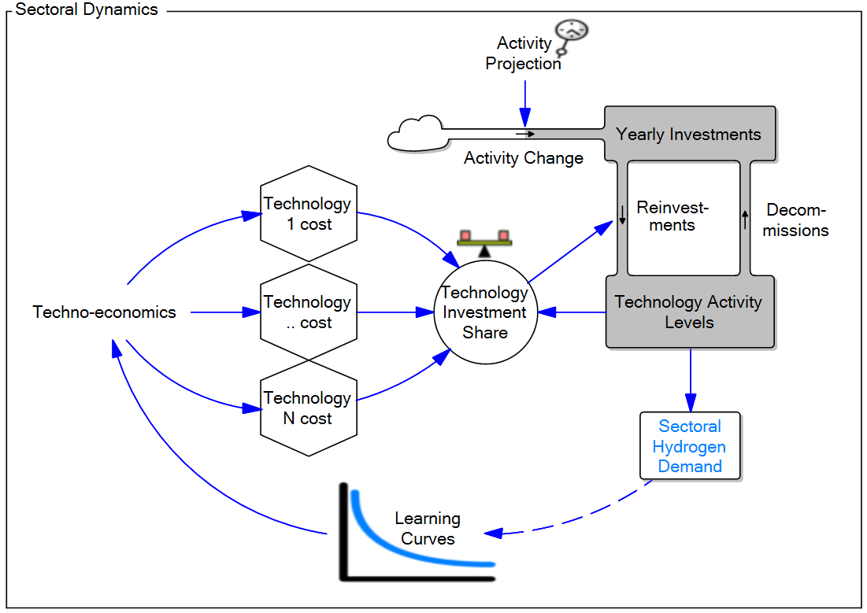
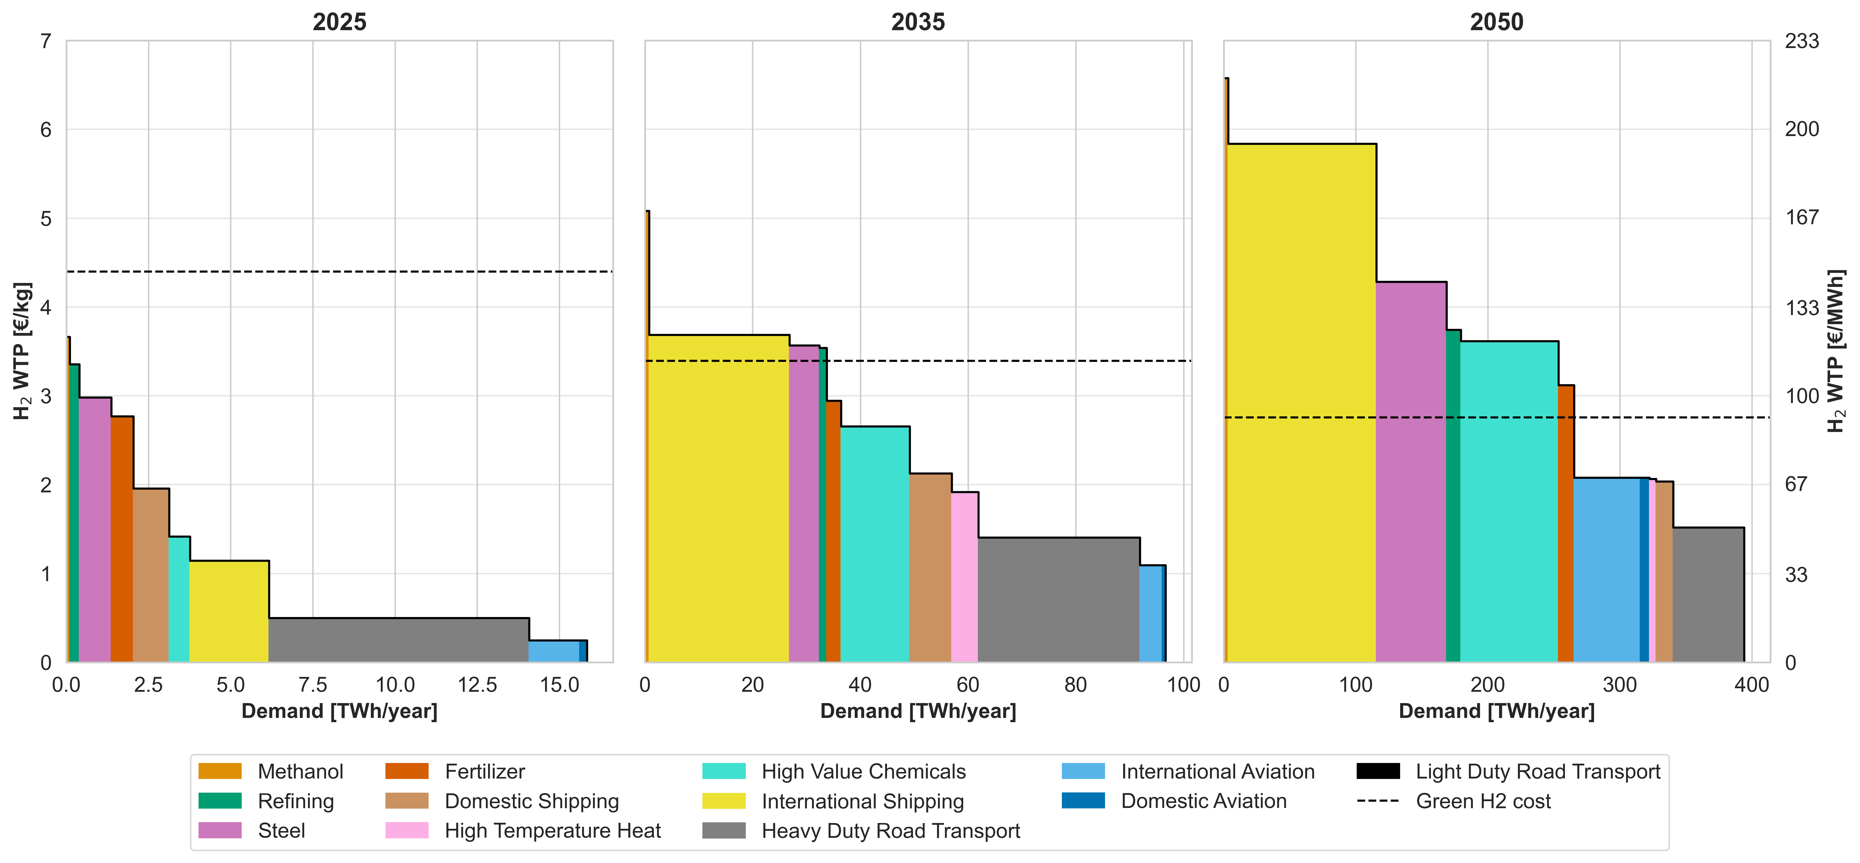
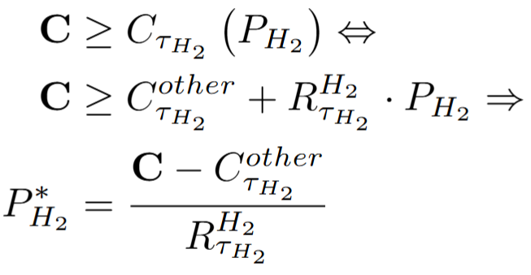
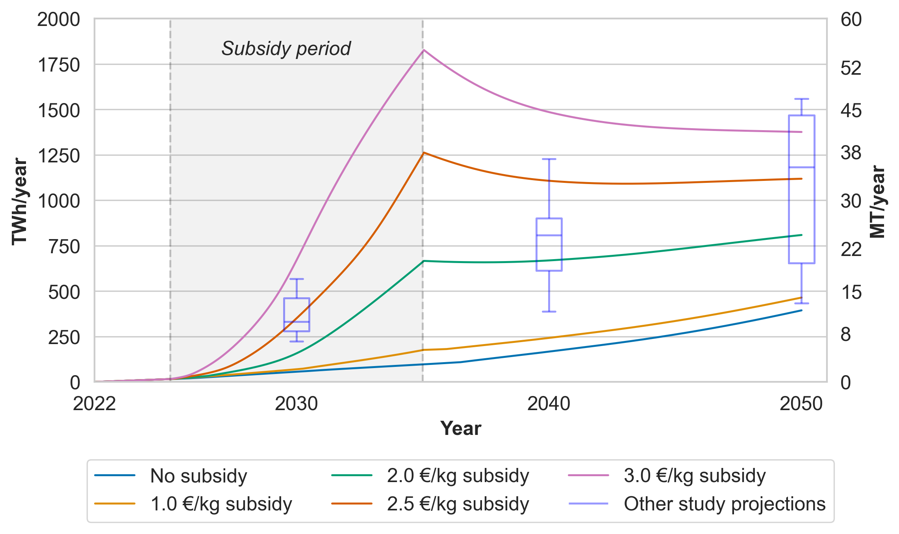
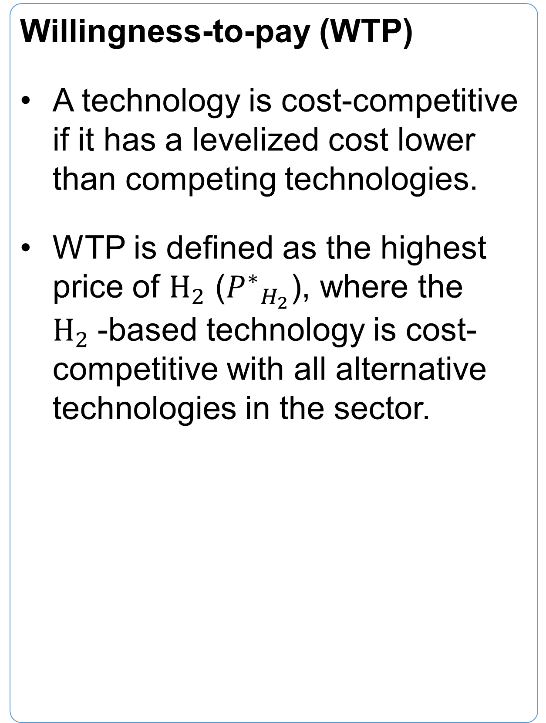
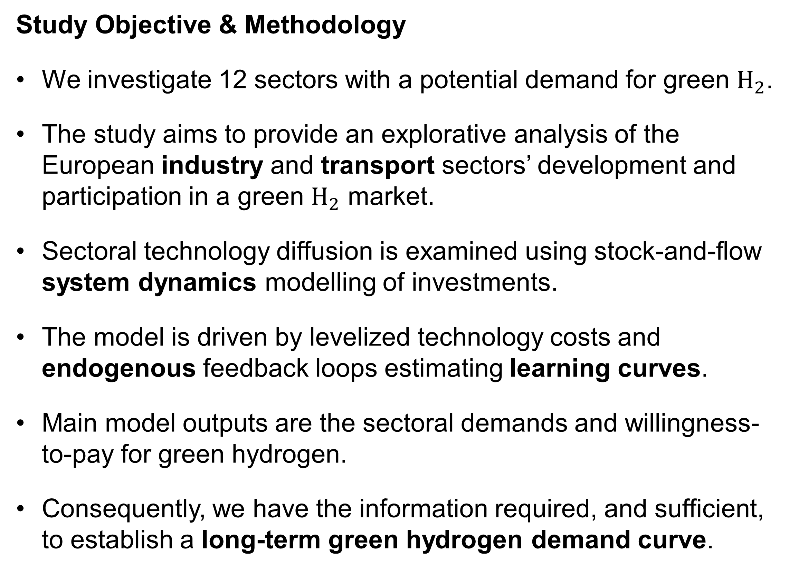
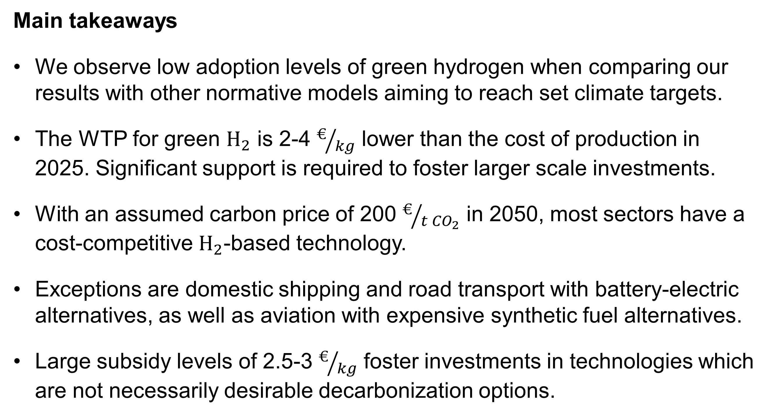
Frederik Skou Fertin, MSc Sustainable Energy Systems, DTU
A Sectoral European Hydrogen Demand Curve
Study Objective & Methodology
We investigate 12 sectors with a potential demand for green $H_{2}$.
The study aims to provide an explorative analysis of the European industry and transport sectors’ development and participation in a green $H_{2}$ market.
Sectoral technology diffusion is examined using stock-and-flow system dynamics modelling of investments.
The model is driven by levelized technology costs and endogenous feedback loops estimating learning curves.
Main model outputs are the sectoral demands and willingness-to-pay for green hydrogen.
Consequently, we have the information required, and sufficient, to establish a long-term green hydrogen demand curve.
Green Hydrogen Demand Curves
Willingness-to-pay (WTP)
A technology is cost-competitive if it has a levelized cost lower than competing technologies.
WTP is defined as the highest price of $H_{2}$ (${P^{∗}}_{H_{2}}$), where the $H_{2}$-based technology is cost-competitive with all alternative technologies in the sector.
Hydrogen Demand Projections
Main takeaways
We observe low adoption levels of green hydrogen when comparing our results with other normative models aiming to reach set climate targets.
The WTP for green $H_{2}$ is 2-4 $€/{kg}$ lower than the cost of production in 2025. Significant support is required to foster larger scale investments.
With an assumed carbon price of 200 $€/{{t CO}_{2}}$ in 2050, most sectors have a cost-competitive $H_{2}$-based technology.
Exceptions are domestic shipping and road transport with battery-electric alternatives, as well as aviation with expensive synthetic fuel alternatives.
Large subsidy levels of 2.5-3 $€/{kg}$ foster investments in technologies which are not necessarily desirable decarbonization options.

